Slide 1

Agile Requirements
Introducing User Stories

Slide 2
Key Principles for Agile Requirements
Active user involvement is imperative
Agile teams must be empowered to make decisions
Requirements emerge and evolve as software is developed
Agile requirements are ‘barely sufficient’
Requirements are developed in small, bite-sized pieces
Enough’s enough – apply the 80/20 rule
Cooperation, collaboration and communication
between all team members is essential

Slide 3
Requirements are a Communication Problem
Written requirements
  can be well thought through, reviewed and edited
  provide a permanent record
  are more easily shared with groups of people
  time consuming to produce
  may be less relevant or superseded over time
  can be easily misinterpreted
Verbal requirements
  instantaneous feedback and clarification
  information-packed exchange
  easier to clarify and gain common understanding
  more easily adapted to any new information known at the time
  can spark ideas about problems and opportunities

Slide 4

A picture is worth a thousand words

Slide 5
User Stories seek to combine the strengths of written and verbal communication, where possible supported by a picture.

Slide 6
What is a User Story?
A concise, written description
of a piece of functionality
that will be valuable to a user
(or owner) of the software.

Slide 7
User Story Cards have 3 parts
Card - A written description of the user story for planning purposes and as a reminder
Conversation - A section for capturing further information about the user story and details of any conversations
Confirmation - A section to convey what tests will be carried out to confirm the user story is complete and working as expected

Slide 8
User Story Description
As a [user role] I want to [goal]
so I can [reason]
For example:
As a registered user I want to log in
so I can access subscriber-only content

Slide 9
User Story Description
Who (user role)
  What (goal)
Why (reason)
  gives clarity as to why a feature is useful
  can influence how a feature should function
  can give you ideas for other useful features
  that support the user's goals

Slide 10
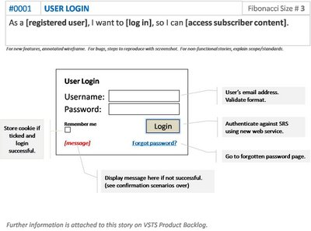
User Story Example: Front of Card

Slide 11
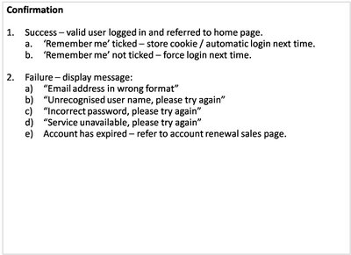
User Story Example: Back of Card

Slide 12
How detailed should a User Story be?
Detailed enough for the team to start work from,
and further details to be established and clarified
at the time of development.

Slide 13
INVEST in Good User Stories
Independent – User Stories should be as independent as possible.
Negotiable – User Stories are not a contract. They are not detailed specifications. They are reminders of features for the team to discuss and collaborate to clarify the details near the time of development.
Valuable – User Stories should be valuable to the user (or owner) of the solution. They should be written in user language. They should be features, not tasks.
Estimatable – User Stories need to be possible to estimate. They need to provide enough information to estimate, without being too detailed.
Small – User Stories should be small. Not too small. But not too big.
Testable – User Stories need to be worded in a way that is testable, i.e. not too subjective and to provide clear details of how the User Story will be tested.

Slide 14
User Stories Summary
User Stories combine written and verbal communications, supported with a picture where possible.
User Stories should describe features that are of value to the user, written in a user’s language.
User Stories detail just enough information and no more.
Details are deferred and captured through collaboration
just in time for development.
Test cases should be written before development, when the User Story is written.
User Stories should be Independent, Negotiable, Valuable, Estimatable, Small and Testable.

Slide 15
Writing Good User Stories
http://www.agile-software-development.com/2008/04/writing-good-user-stories.html

